Slide 2
Federating queries to Databricks from SAP Datasphere
November 2-3, 2023

Slide 3

Agenda
01 Overview
02 Business Challenges & Proposed Solution
03 Solution Overview
04 SAP Datasphere & Databricks Role
05 Existing Setup & Jumpstart
06 Important Links
07 Hands-On

Slide 4
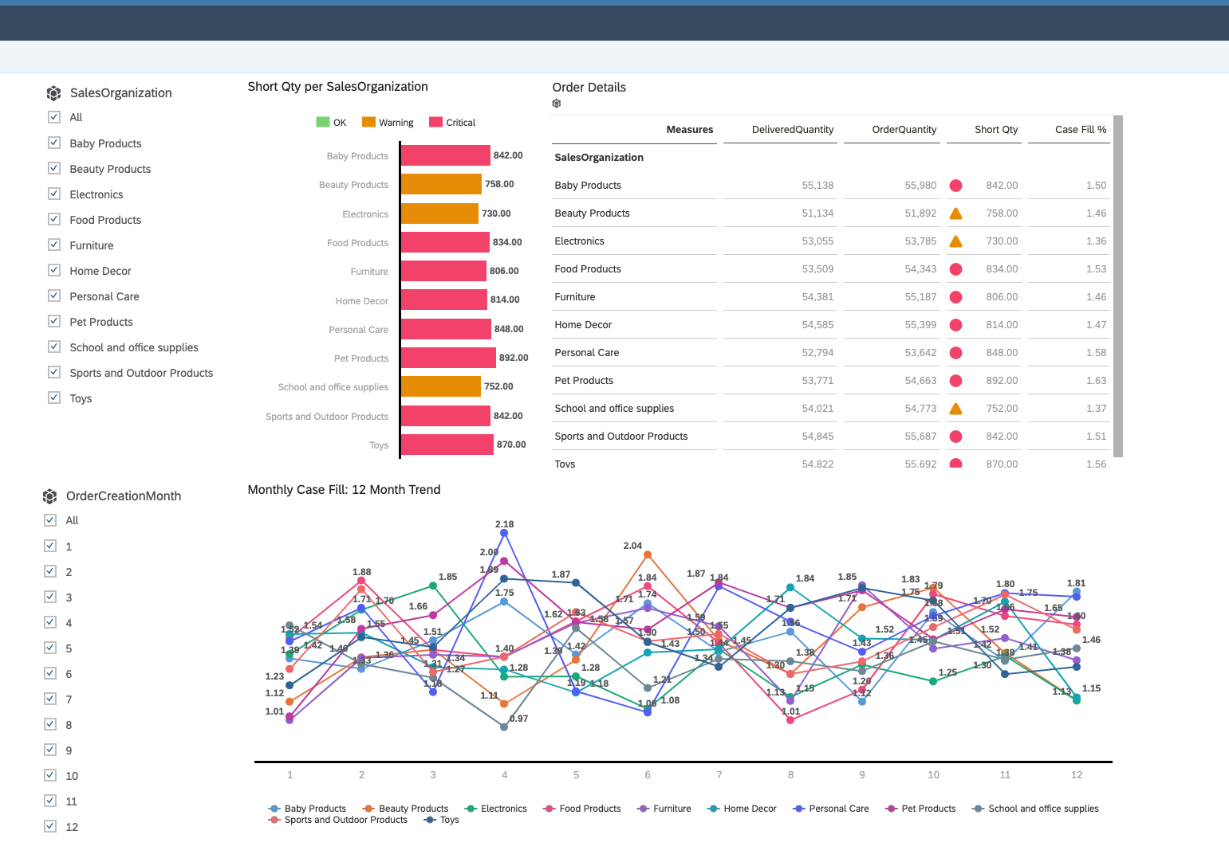
Overview
In this hands-on you are going to analyze Sales order Monthly order fill rate. Order fill rate is the number of product units initially shipped as a percentage of all units ordered. An order fill rate can apply to both inbound units for a warehouse as well as outbound units for distributors and carriers.
You can see how to do unified analytics by creating unified business models that combine federated non-SAP data from Databricks with SAP business data to derive real-time business insights.

Slide 5
Business Challenges & Proposed Solutions
For many companies, data strategy may involve storing business data in independent silos at different repositories. Some of that data may even cross different cloud sources (for cost and other reasons) which brings along new challenges with data fragmentation, data duplication and loss of data context.
Datasphere helps bridge siloed and cross cloud SAP and non-SAP data sources enabling businesses to get richer business insights, all while keeping the data at its original location and eliminating the need to duplicate data and time consuming ETLs.
Notes:
What is Databricks? It’s relevance with SAP Datashpere

Slide 6
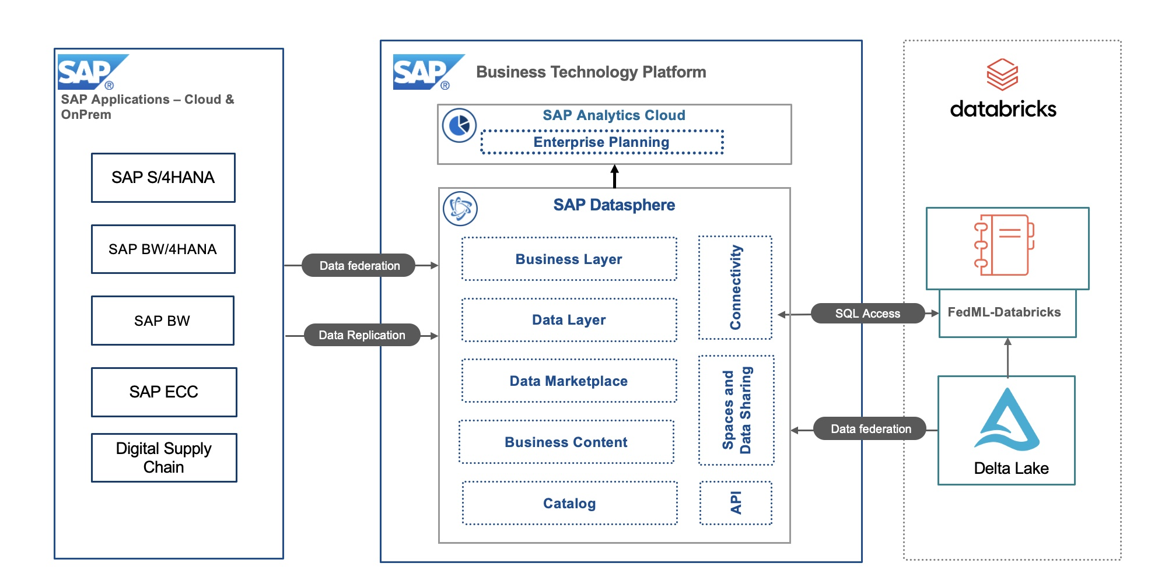
Solution Overview
The architecture highlights the main purpose of this integration, federating data residing in Databricks delta lake into SAP Datasphere.
We do this to achieve richer analytics by incorporating data that would otherwise remain unused in 3rd party systems with the already valuable insights delivered by SAP data.
We show the different mechanisms by which data can be federated and used in SAP Analytics Cloud without being replicated.

Slide 7
SAP Datasphere & Databricks Role
Role of SAP Business Technology Platform:
With SAP Datasphere, bridge siloed and cross cloud SAP and non-SAP data sources enabling businesses to get richer business insights, all while keeping the data at its original location and eliminating the need to duplicate data and time consuming ETLs.
SAP Analytics Cloud (SAC) customers can execute live on the fly analysis across cross-cloud data sources in real-time (and live analytics to Databricks).
Unified SAP data model and semantics propagated from SAP S/4HANA and SAP CX systems to SAP Datasphere and SAC
Role for Databricks:
Serve as a powerful data processing and ETL (Extract, Transform, Load) platform to prepare the data for analytics.
Perform real-time processing on incoming data streams from SAP Datasphere.
Store the processed data in a suitable format, such as Delta Lake, which is optimized for both batch and real-time processing.
Optimize query performance through features like query optimization and caching to make real-time analytics in SAP Analytics Cloud responsive and efficient.

Slide 8
Existing Setup & Jumpstart
SAP Datasphere Instance already available and configured with spaces and users to explore the provided data model.
SAP Analytics Cloud already setup and configured for analyzing and visualizing the order fill percentage.
You will work with a sample Databricks dataset. To analyze and compare the shipped units with respect to the total units ordered in the sales orders, we will be using the shipment and delivery data from Databricks delta lake which is federated and combined with customer and sales order master data from SAP systems into a unified model used for efficient using SAP Datasphere and SAP Analytics cloud for real-time analytics.
In the "Connections" section of SAP Datasphere we already created live connectivity to AWS Databricks and have already running DP Agent on a separate machine for real-time data. This connection is used in the Hands-on session to create data views on remote tables from AWS Databricks.

Slide 9
Important Link
Discovery center mission
Blogpost

Slide 10
Let’s get started
Hand-On

Slide 11
teched-XXX@education.cloud.sap
Acce$$teched23

Slide 12


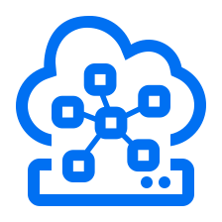





Additional Use Cases
Route Multi-Region Traffic to SAP BTP Services Intelligently ●
● Enable Supplier Collaboration across SAP and Microsoft Azure Ecosystem using SAP BTP
Build Events-to-Business Actions Apps with BTP and Azure/AWS ●
Integration
● Accelerate the digitalization of purchase info record approval process transparently
Distributed Resiliency of SAP CAP application ●
SAP
Business
Technology
Platform
Develop multitenant SaaS application on BTP using CAP ●
Automation
App Development
● Process and approve your invoices with SAP Build Process Automation
Enhance core business processes with resilient apps on BTP ●
Federated Machine Learning Libraries for Hyperscalers ●
● Consume Azure Open AI (GPT) on BTP via AI Core
Data & Analytics
AI (Gen AI)
Explore your Hyperscalers Data with SAP Datasphere ●
● Reduce CO2 footprint using a smart Generative AI app on BTP
Enable Category Management with Big Query and SAP Datasphere ●
● Digitizing Criticality Assessments using SAP AI Core / Launchpad
© 2023 SAP SE or an SAP affiliate company. All rights reserved. See Legal Notice on www.sap.com/legal-notice for use terms, disclaimers, disclosures, or restrictions related to SAP Materials for general audiences.

Slide 13






BTP is the Preferred Choice – Join Us
ˇ
Connect with Us
for accelerated BTP Journey
Know More about Use Cases & Architectures
Build Resilient Apps on SAP BTP with AWS

Slide 14

Accelerate your SAP BTP Journey
Pilot with Us!
Your custom use case
Support: Build a use case for a limited period
Outcome: Successful pilot and reference
Engage with us!
SAP BTP Adoption Program
Scope: app development, automation, Gen AI, cross-cloud analytics
And more…
Reach out to me pvn.pavanvankumar@sap.com

Slide 15







Contributors
Sangeetha Krishnamoorthy
Rajesh Ranjan
Ashwini Deshpande
Akash Amarendra
LinkedIn | Twitter
LinkedIn | Twitter
LinkedIn | Twitter
LinkedIn | Twitter
Lalit Mohan Sharma
Navya Khurana
Uma Anbazhagan
LinkedIn | Twitter
LinkedIn | Twitter
LinkedIn | Twitter
© 2023 SAP SE or an SAP affiliate company. All rights reserved. See Legal Notice on www.sap.com/legal-notice for use terms, disclaimers, disclosures, or restrictions related to SAP Materials for general audiences.

Slide 16
Thank you

